Slide 1
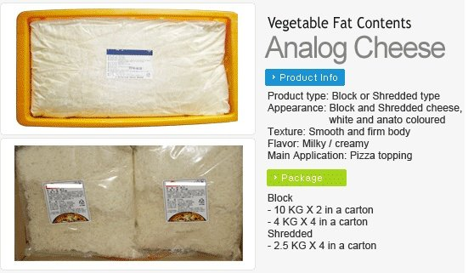
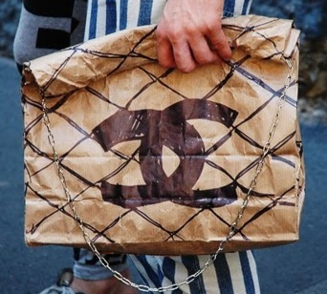
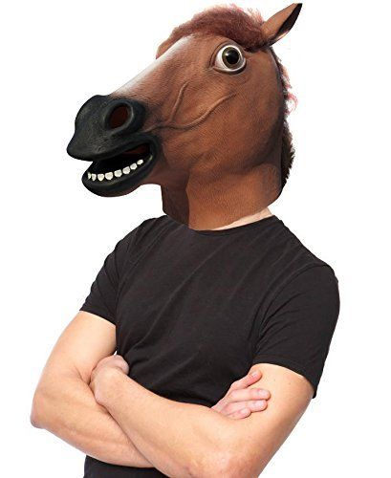
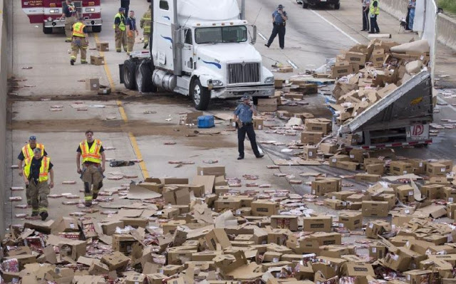
Supply Chains are opaque and as a result are exposed to serious organised crime, fraudulent activity and bending of the rules
Authentic Italian pizza
Not just a plastic bag…
Delivery standards guaranteed
100% minced beef

